Slide 1
Timing

Slide 2
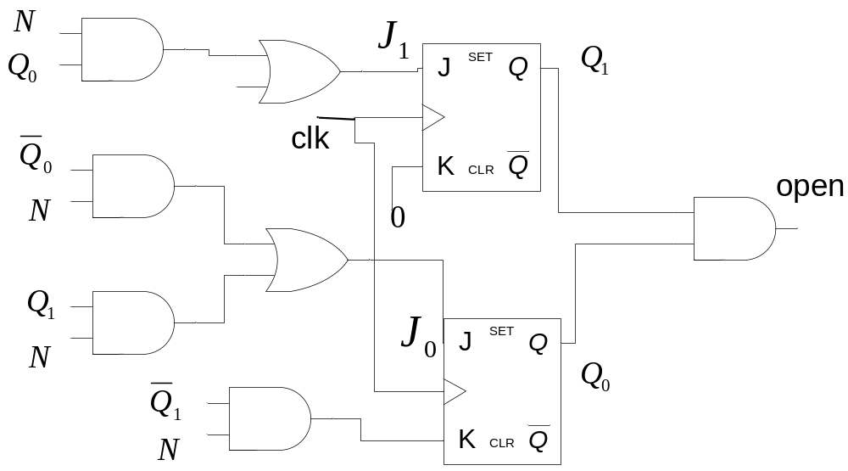
Vending Machine- J-K flip flops implementation
J₁ = D+Q₀ .N
J₀ = Q₁’ . N +Q₁. D
K₁ = 0
K₀ = Q₁’ . N

Slide 3
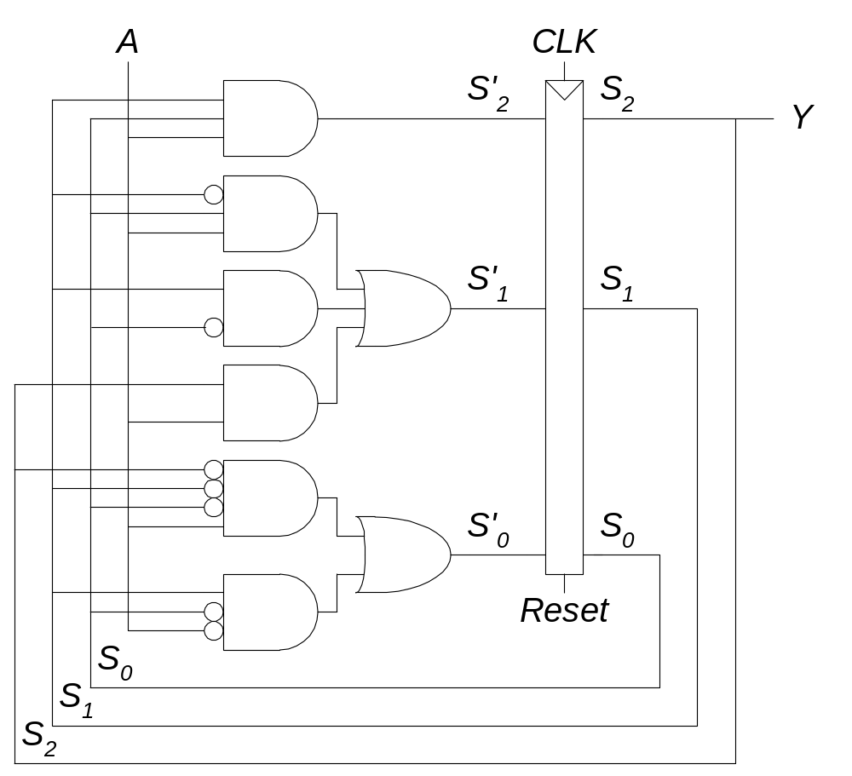
Moore FSM Schematic

Slide 4
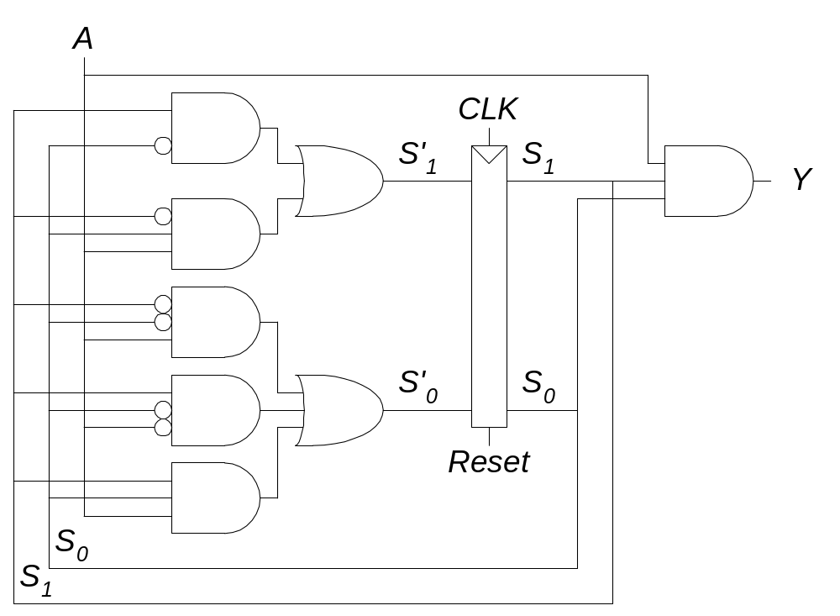
Mealy FSM Schematic

Slide 5
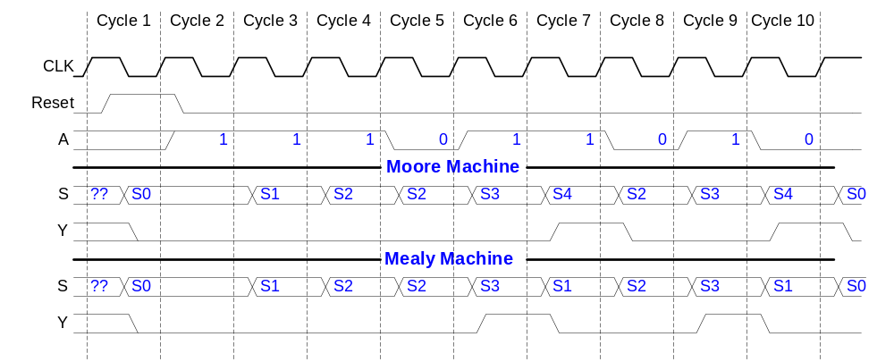
Moore and Mealy Timing Diagram

Slide 6
Additional Considerations
Non-Ideal Gate Behavior -- Delay
x
1
1
1
F
x
x
x
y
0
0
0
1
1
1
y
y
y
0
0
0
(1.8
V)
1
1
1
F
F
F
(0
V)
0
0
0
time
time
time
(
a
)
(
b
)
a
(
c
)
ideal
a
more realistic
with delay but otherwise ideal
a
Real gates have some delay
  Outputs don’t change immediately after inputs change

Slide 7
Circuit Delay and Critical Path
k
p
1 ns
1 ns
1 ns
1 ns
w
a
s
1 ns
1+1+1+1+1 = 5 ns
1 ns
1 ns
1 ns
1+0.5+1+1+1+1+1 = 6.5 ns
0.5 ns
t
1 ns
1+1+1 = 3 ns
C
r
itical path del
a
y = 6.5 ns
Henc
e
, circuit
’
s del
a
y is 6.5 ns
Wires also have delay
Assume gates and wires have delays as shown
Path delay – time for input to affect output
Critical path – path with longest path delay
Circuit delay – delay of critical path

Slide 8
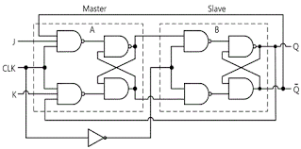
J-K Flip Flop

Slide 9
Timing
Flip-flop samples D at clock edge
D must be stable when it is sampled
Similar to a photograph, D must be stable around the clock edge
If D is changing when it is sampled, metastability can occur

Slide 10
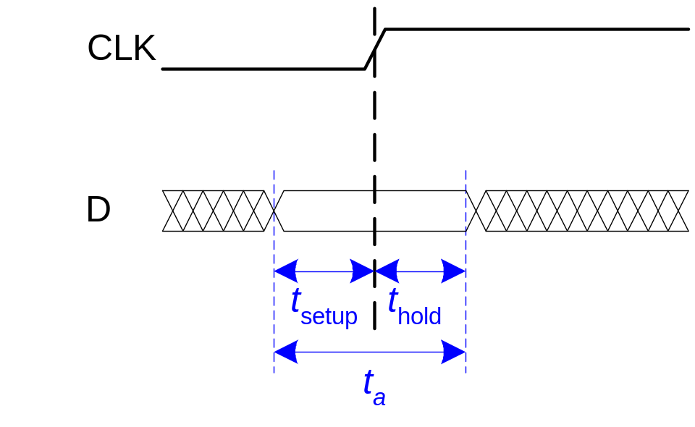
Input Timing Constraints
Setup time: t_{setup} = time before the clock edge that data must be stable (i.e. not changing)
Hold time: t_{hold} = time after the clock edge that data must be stable
Aperture time: t_{a} = time around clock edge that data must be stable (t_{a} = t_{setup} + t_{hold})

Slide 11
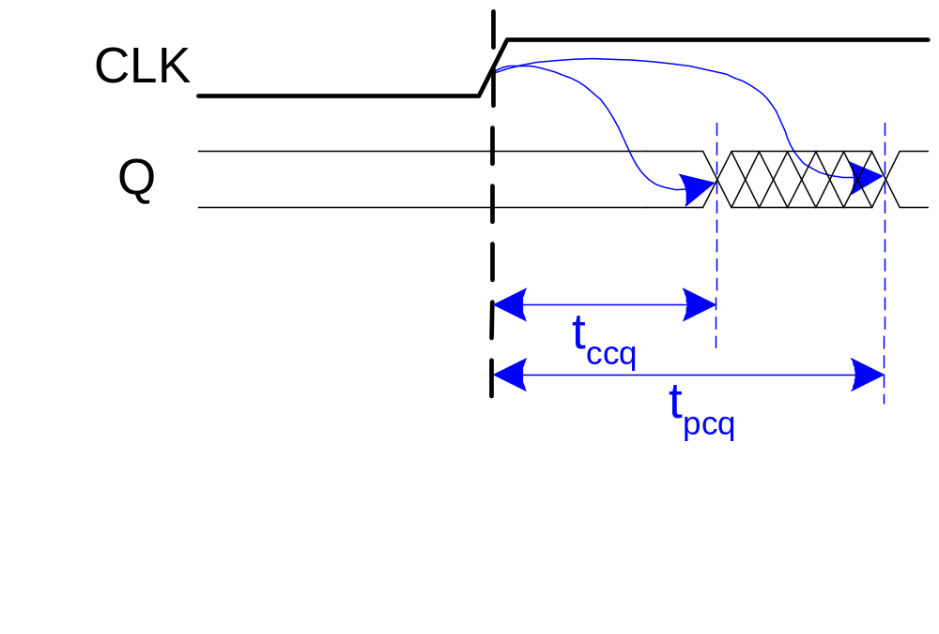
Output Timing Constraints
Propagation delay: t_{pcq} = time after clock edge that the output Q is guaranteed to be stable (i.e., to stop changing)
Contamination delay: t_{ccq} = time after clock edge that Q might be unstable (i.e., start changing)

Slide 12
Dynamic Discipline
The input to a synchronous sequential circuit must be stable during the aperture (setup and hold) time around the clock edge.
Specifically, the input must be stable
  at least t_{setup} before the clock edge
  at least until t_{hold} after the clock edge

Slide 13
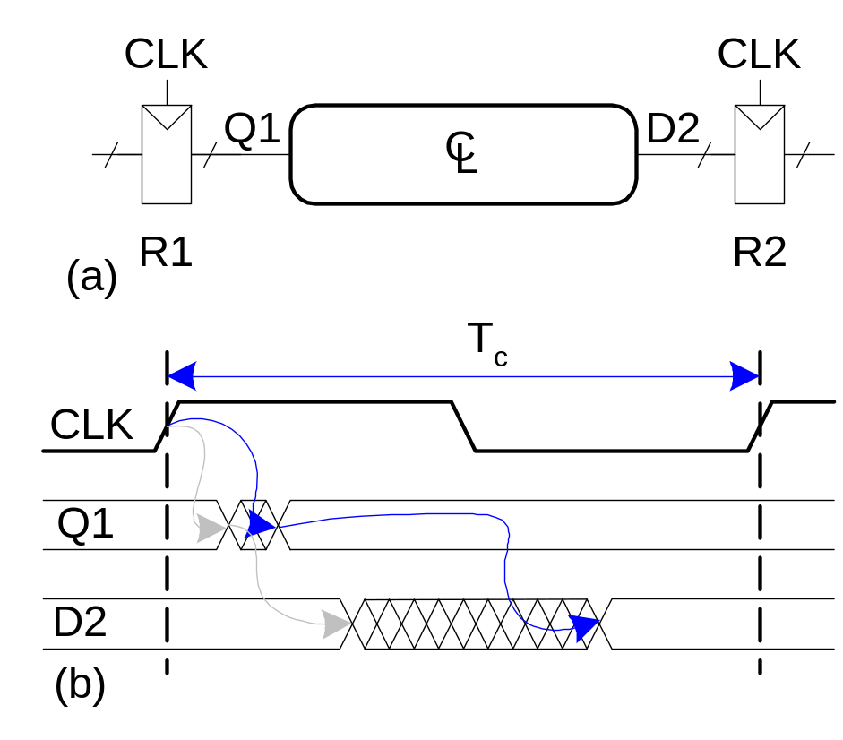
Timing
The delay between registers has a minimum and maximum delay, dependent on the delays of the circuit elements

Slide 14
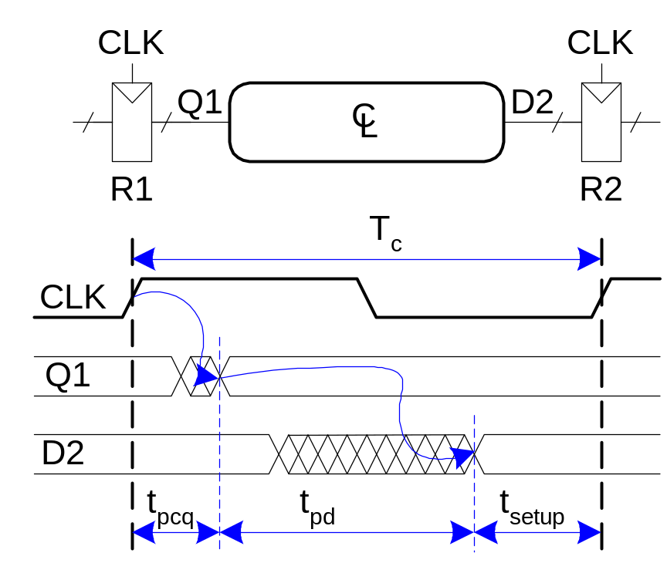
Setup Time Constraint
The setup time constraint depends on the maximum delay from register R1 through the combinational logic.
The input to register R2 must be stable at least t_{setup} before the clock edge.
T_{c} ≥

Slide 15
Setup Time Constraint
The setup time constraint depends on the maximum delay from register R1 through the combinational logic.
The input to register R2 must be stable at least t_{setup} before the clock edge.
T_{c} ≥ t_{pcq} + t_{pd} + t_{setup}
t_{pd} ≤

Slide 16
Setup Time Constraint
The setup time constraint depends on the maximum delay from register R1 through the combinational logic.
The input to register R2 must be stable at least t_{setup} before the clock edge.
T_{c} ≥ t_{pcq} + t_{pd} + t_{setup}
t_{pd} ≤ T_{c} – (t_{pcq} + t_{setup})

Slide 17
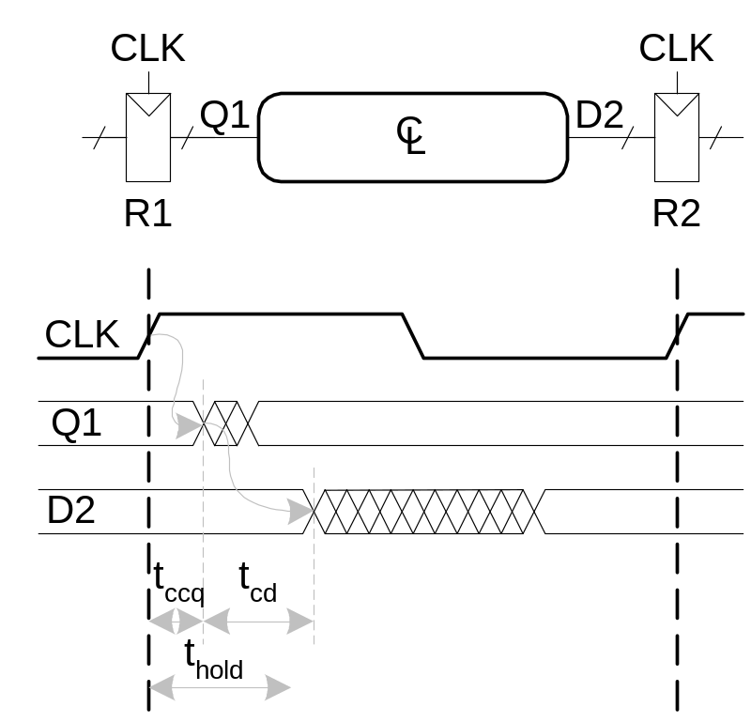
Hold Time Constraint
The hold time constraint depends on the minimum delay from register R1 through the combinational logic.
The input to register R2 must be stable for at least t_{hold} after the clock edge.
t_{hold} <

Slide 18
Hold Time Constraint
The hold time constraint depends on the minimum delay from register R1 through the combinational logic.
The input to register R2 must be stable for at least t_{hold} after the clock edge.
t_{hold} < t_{ccq} + t_{cd}
t_{cd} >

Slide 19
Hold Time Constraint
The hold time constraint depends on the minimum delay from register R1 through the combinational logic.
The input to register R2 must be stable for at least t_{hold} after the clock edge.
t_{hold} < t_{ccq} + t_{cd}
t_{cd} > t_{hold} - t_{ccq}

Slide 20
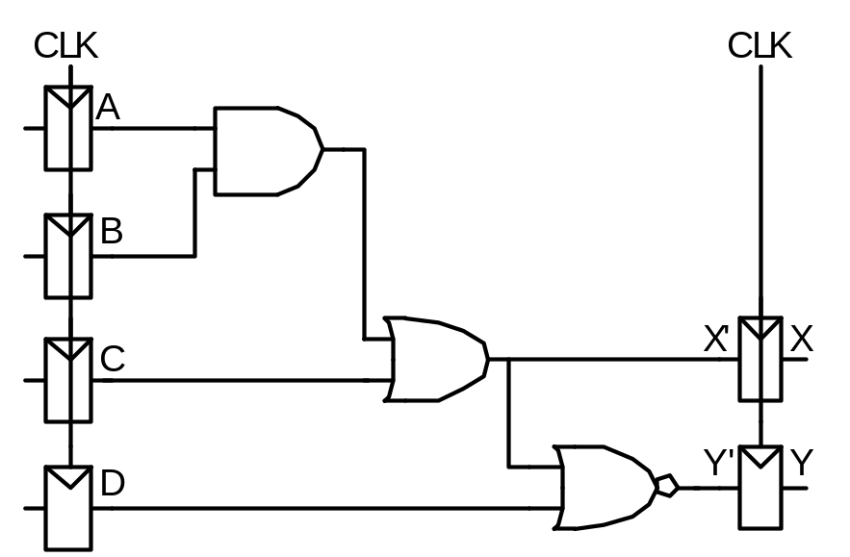
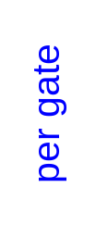

Timing Analysis
Timing Characteristics
t_{ccq} = 30 ps
t_{pcq} = 50 ps
t_{setup} = 60 ps
t_{hold} = 70 ps
t_{pd} = 35 ps
t_{cd} = 25 ps
t_{pd} =
t_{cd} =
Setup time constraint:
T_{c} ≥
f_{c} = 1/T_{c} =
Hold time constraint:
t_{ccq} + t_{pd} > t_{hold} ?

Slide 21
Timing Analysis
Timing Characteristics
t_{ccq} = 30 ps
t_{pcq} = 50 ps
t_{setup} = 60 ps
t_{hold} = 70 ps
t_{pd} = 35 ps
t_{cd} = 25 ps
t_{pd} = 3 x 35 ps = 105 ps
t_{cd} = 25 ps
Setup time constraint:
T_{c} ≥ (50 + 105 + 60) ps = 215 ps
f_{c} = 1/T_{c} = 4.65 GHz
Hold time constraint:
t_{ccq} + t_{pd} > t_{hold} ?
(30 + 25) ps > 70 ps ? No!

Slide 22
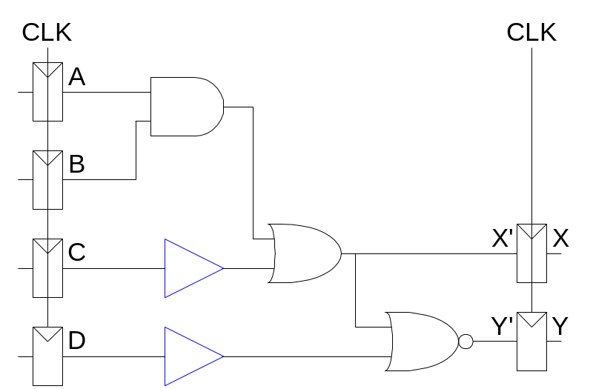
Fixing Hold Time Violation
Add buffers to the short paths:
Timing Characteristics
t_{ccq} = 30 ps
t_{pcq} = 50 ps
t_{setup} = 60 ps
t_{hold} = 70 ps
t_{pd} = 35 ps
t_{cd} = 25 ps
t_{pd} =
t_{cd} =
Setup time constraint:
T_{c} ≥
f_{c} =
Hold time constraint:
t_{ccq} + t_{pd} > t_{hold} ?

Slide 23
Fixing Hold Time Violation
Add buffers to the short paths:
Timing Characteristics
t_{ccq} = 30 ps
t_{pcq} = 50 ps
t_{setup} = 60 ps
t_{hold} = 70 ps
t_{pd} = 35 ps
t_{cd} = 25 ps
t_{pd} = 3 x 35 ps = 105 ps
t_{cd} = 2 x 25 ps = 50 ps
Setup time constraint:
T_{c} ≥ (50 + 105 + 60) ps = 215 ps
f_{c} = 1/T_{c} = 4.65 GHz
Hold time constraint:
t_{ccq} + t_{pd} > t_{hold} ?
(30 + 50) ps > 70 ps ? Yes!

Slide 24
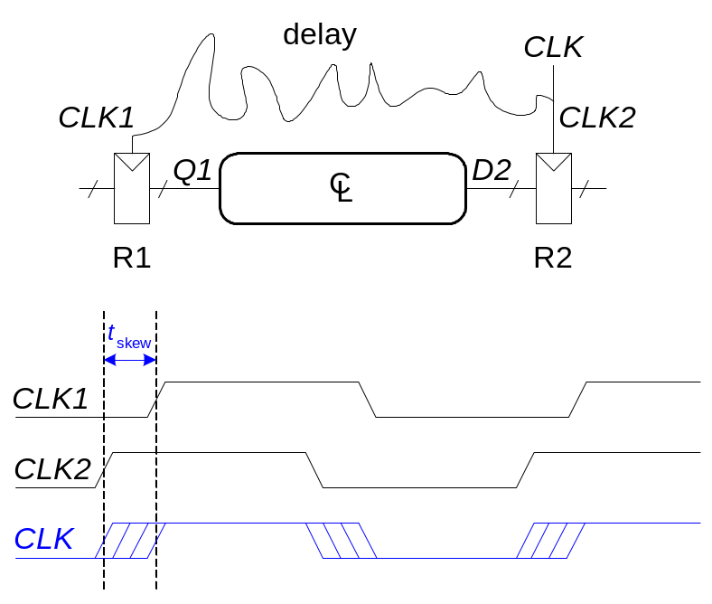
Clock Skew
The clock doesn’t arrive at all registers at the same time
Skew is the difference between two clock edges
Examine the worst case to guarantee that the dynamic discipline is not violated for any register – many registers in a system!

Slide 25
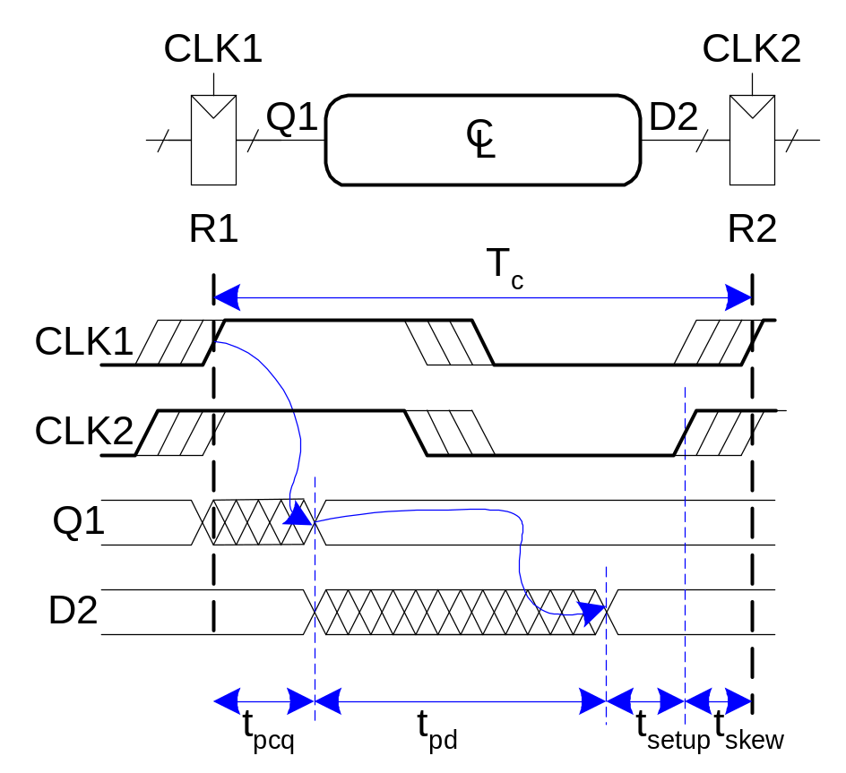
Setup Time Constraint with Clock Skew
In the worst case, the CLK2 is earlier than CLK1
T_{c} ≥

Slide 26
Setup Time Constraint with Clock Skew
In the worst case, the CLK2 is earlier than CLK1
T_{c} ≥ t_{pcq} + t_{pd} + t_{setup} + t_{skew}
t_{pd} ≤

Slide 27
Setup Time Constraint with Clock Skew
In the worst case, the CLK2 is earlier than CLK1
T_{c} ≥ t_{pcq} + t_{pd} + t_{setup} + t_{skew}
t_{pd} ≤ T_{c} – (t_{pcq} + t_{setup} + t_{skew})

